Slide 1
RESUME PARSING AND JOB MATCHING
Jaini Gala ​
Raghav Rastogi​
Srijha Kalyan​
Kartik Ullal

Slide 2
Introduction
It has long been a challenge for software developers to create resume parsing tools that are accurate, efficient, and can detect all the information that recruiters need. Corporate companies and recruitment agencies process numerous resumes daily. This is no task for humans. An automated intelligent system is required which can take out all the vital information from the unstructured resumes and transform all of them to a common structured format which can then be scored for a specific job position.

Slide 3
Problem Statement
The main objective of NLP-based Resume Parser in Python project is to create a web application that extracts the required information about candidates and performs similarity detection with job description and score the resumes.
Following are the key inputs and expected outputs.
Input : Resume PDF and Job description text
Output : Labelled data(Name, organization, skills, etc) and Similarity Score between the job description and Resume.

Slide 4
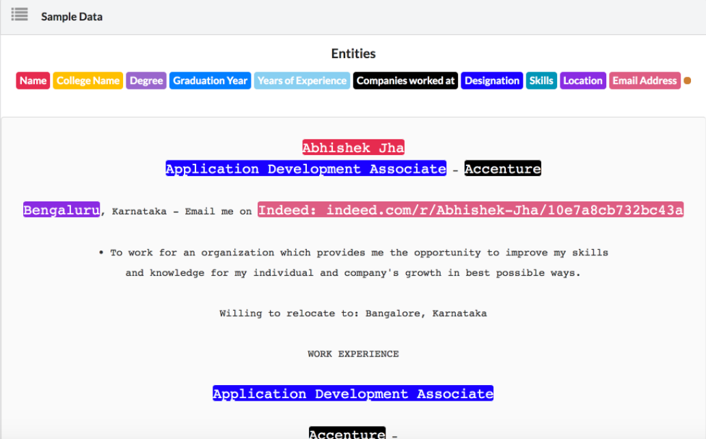
Resume Parser Dataset
Following is the link to our data set:​
Dataset description: The dataset has 220 items of which all the resumes have been manually labeled using the dataturks annotation tool and have been converted into a json format suitable for spacy NER model. ​
The labels are divided into the following 10 categories:​
Name​
College Name​
Degree​
Graduation Year​
Years of Experience​
Companies worked at​
Designation​
Skills​
Location​
Email Address​
Source

Slide 5
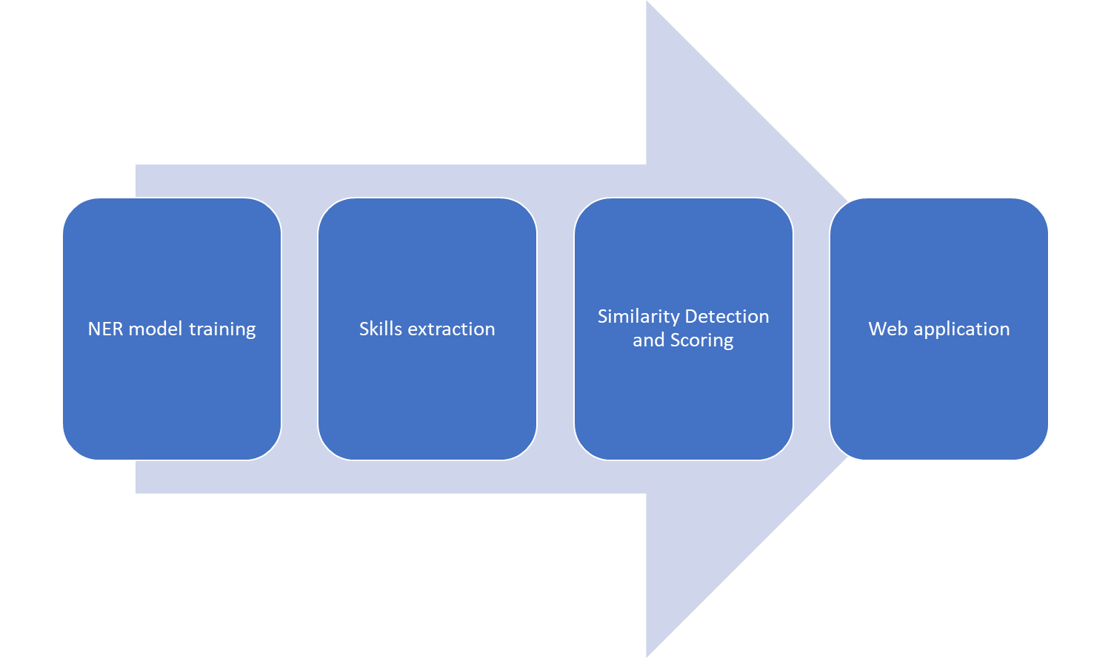
Project workflow

Slide 6
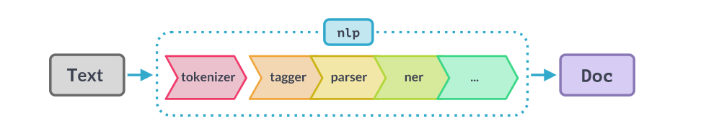
NER Model training
SpaCy first tokenizes the text to produce a Doc object. The Doc is then processed in several different steps – this is also referred to as the processing pipeline. We use following components in the pipeline
Tagger - Assigns part-of-speech tags.
Parser - Assigns dependency labels
NER - Detect and label named entities
We split our data to training and test set and train this model using the annotated and labelled training set and get the accuracy on the test set.
Notes:
Starting with training of the NER model. Our aim is to present the labelled text of the key data in the resume. To do that we use Spacy for training in which NER system contains a word embedding strategy using sub word features and a deep convolutional neural network with residual connections.

Slide 7
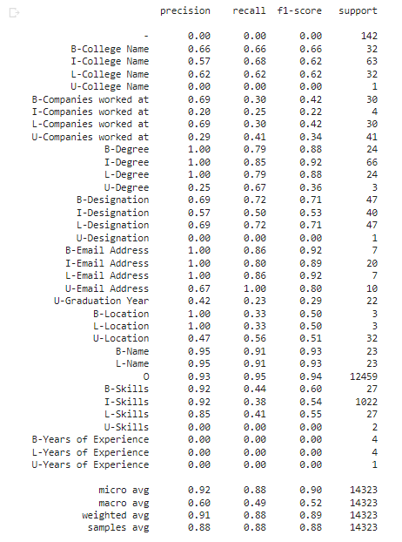

Accuracy report on the test set
We evaluate the model from the attached classification report of the words. Here the label “B”, “I”, “L”, “O” and “U” stands for the following :
B - Words that are in the 'Beginning' of Named Entity
I - Words that are in the 'Inside of Named Entity
L - Words that are in the 'Last' of Named Entity
O - Words that are in the 'Outside' of Named Entity
U - ‘Unit’ length of Named Entity
Accuracy:
Notes:
Here we see the accuracy of the model on the test set. We have the categories like recognizing the names, colleges, companies, designation, email, etc which are splitted into the position of each word in named entity. For example - Arizona state University will have Arizona as the B or the beginning of college name, State as the I or inside the college name and university as the end of the college name. This precise split helps in exactly looking at where the model is making mistakes and how to correct them. Finally we see the overall accuracy at around 88% currently.

Slide 8
Skills Extraction
Once the NER model extracts all the entities from the document, we developed a function that extracts only the skills from all the entities.
We pass the job description through the same NER model and extraction function to extract the required skills for the job.
We then use the skills extracted from the resume and job description to calculate the similarity between the two.

Slide 9
Similarity Detection and Scoring
Converted the skills extracted from the resume and job descriptions into sentence embeddings.
For sentence embeddings, we have used two different models. The first model was Doc2Vec model by Mikilov and Le. Second model was a Sentence Transformer called the Sentence-Bert by Nils Reimers and Iryna Gurevych.
Calculated Cosine Similarity for both the embeddings for the resume skills and the job description skills, to get a similarity score.

Slide 10
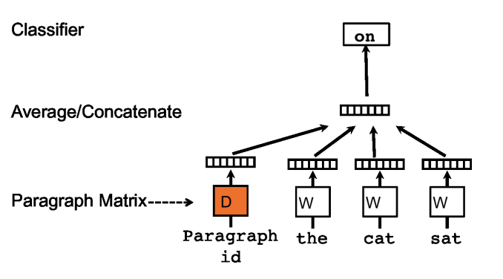
Similarity Detection and Scoring
Doc2Vec :
This algorithm is similar to Word2Vec, but instead of providing word embeddings, it provides one single embedding for a document of variable size.
This model is similar to word2vec CBOW model, but the only change in this model that the average/concatenation is done using the words and the paragraph id.
Notes:
While predicting, we perform inference step to get paragraph vector for next paragraph to word vectors W and the softmax weights, are fixed.

Slide 11
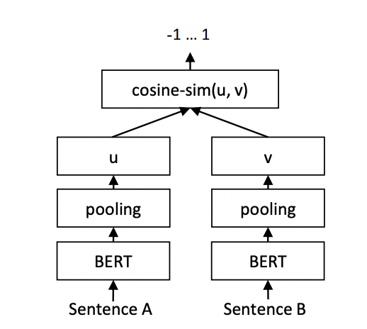
Similarity Detection and Scoring
Sentence BERT (SBERT):
SBERT adds a pooling operation to the output of BERT / RoBERTa to derive a fixed sized sentence embedding.
Pooling can be a mean or max pooling technique.
SBERT is trained on a combination of the SNLI and Multi-NLI dataset which contain annotated 570,000 sentence pairs and 430,000 sentence pairs respectively.

Slide 12
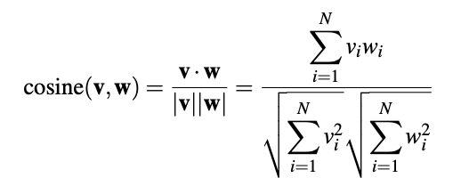
Similarity Detection and Scoring
Cosine Similarity :
To measure the similarity between the skills, we used the vector embeddings from our model and calculated the cosine similarity between them.
The cosine—like most measures for vector similarity used in NLP—is based on normalized dot product.
This normalized dot product turns out to be the same as the cosine of the angle between the two vectors.

Slide 13
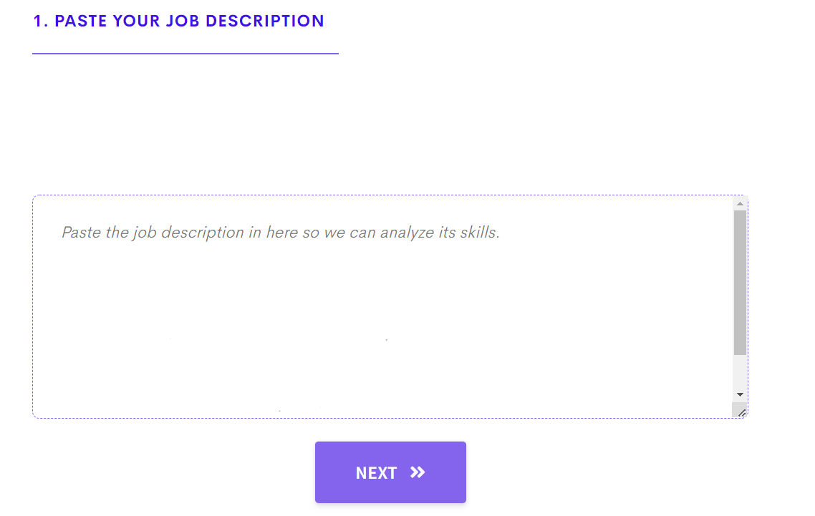
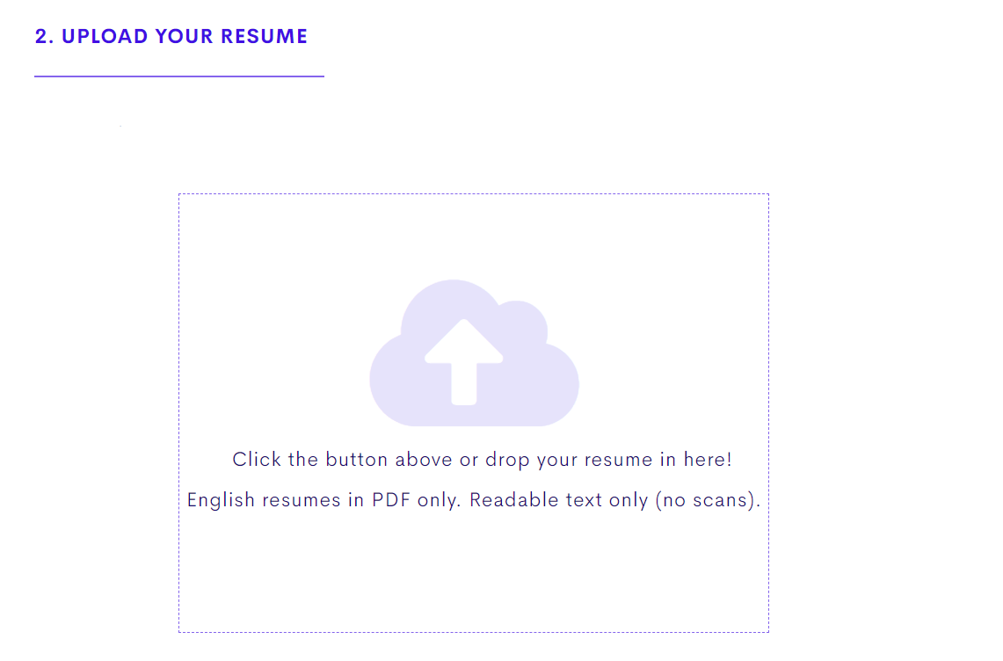
Web Application

Slide 14
References
https://www.kaggle.com/dataturks/resume-entities-for-ner​
https://deepnote.com/@abid/spaCy-Resume-Analysis-gboeS3-oRf6segt789p4Jg​
https://alwaysbelearning.nl/matching-resumes-with-job-offers-using-spacy-a-natural-language-processing-nlp-library-in-python/​
https://www.youtube.com/watch?v=HJy11kOlgvk&t=2s​
https://arxiv.org/pdf/1405.4053.pdf
https://arxiv.org/pdf/1908.10084.pdf
​

